Slide 1

Course Name: Hardware Security
Faculty Name: Prof Debdeep Mukhopadhyay
Department : Computer Science and Engineering
Topic
Lecture 14: Hardware Implementation of Advanced Encryption (contd.)

Slide 2

Concepts Covered:
AES in Composite Fields
Mix Columns Implementation
S-Box Implementation Approaches
Composite Field AES
Intel AES Instruction

Slide 3
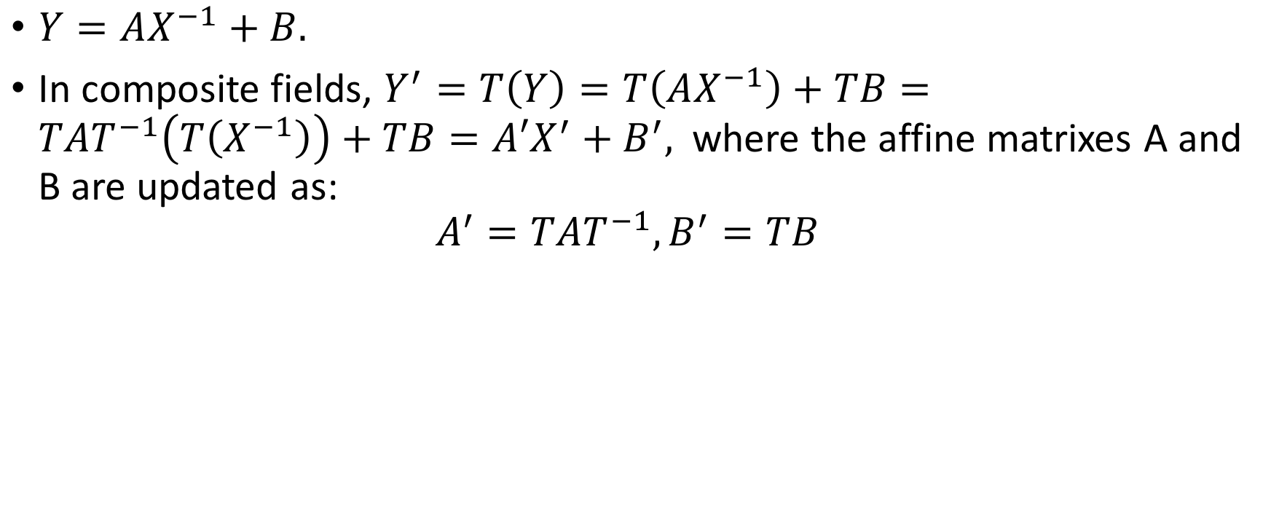
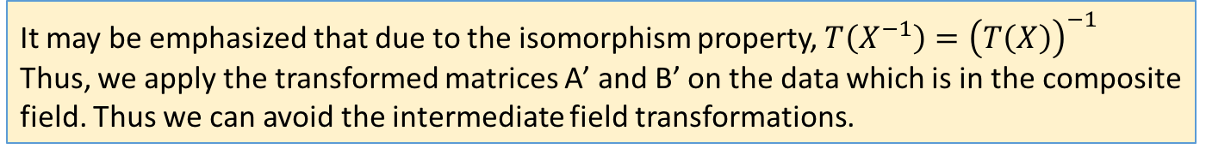
SubBytes in Composite Fields
$Y=AX^{−1}+B.$
In composite fields, $Y^{′}=T\left(Y\right)=T\left(AX^{−1}\right)+TB=TAT^{−1}\left(T\left(X^{−1}\right)\right)+TB=A{′X}^{′}+B^{′},$where the affine matrixes A and B are updated as:
$$A^{′}=TAT^{−1},B^{′}=TB$$
It may be emphasized that due to the isomorphism property, $T\left(X^{−1}\right)={\left(T\left(X\right)\right)}^{−1}$
Thus, we apply the transformed matrices A’ and B’ on the data which is in the composite field. Thus we can avoid the intermediate field transformations.

Slide 4
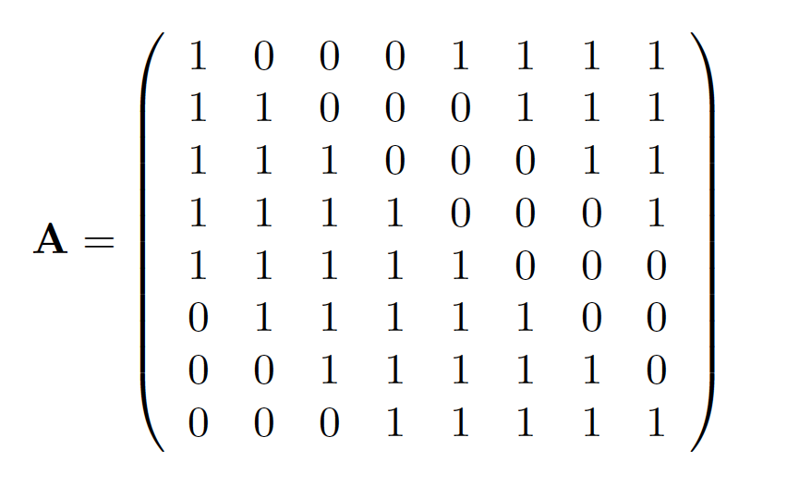
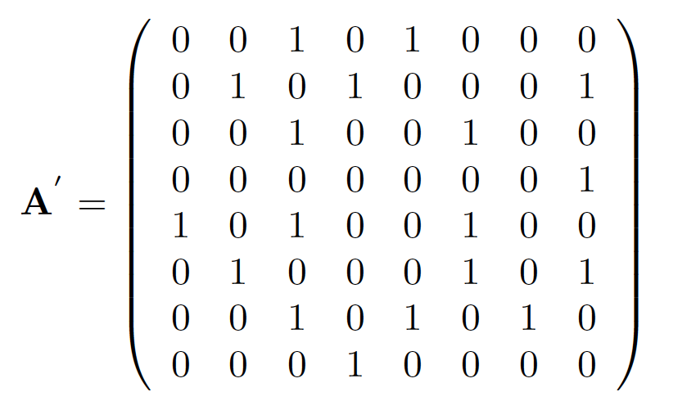
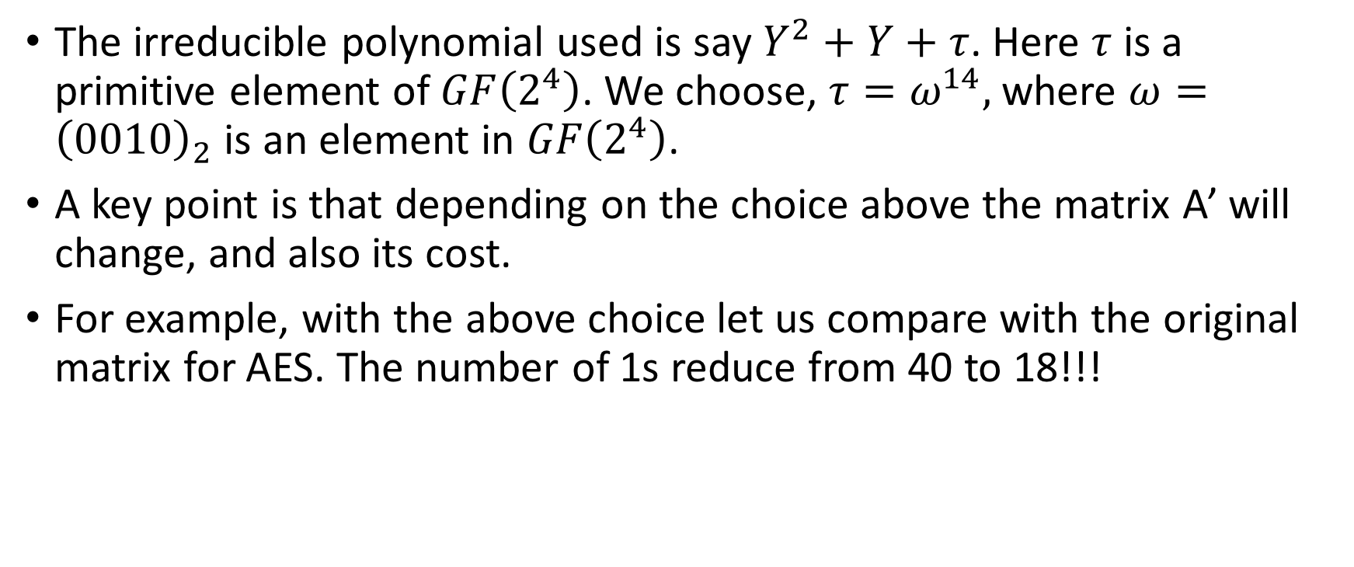
Effect on the matrix values of the Affine Transformation
The irreducible polynomial used is say $Y^{2}+Y+τ$. Here $τ$ is a primitive element of $GF\left(2^{4}\right)$. We choose, $τ=ω^{14},$where $ω={\left(0010\right)}_{2}$ is an element in $GF\left(2^{4}\right)$.
A key point is that depending on the choice above the matrix A’ will change, and also its cost.
For example, with the above choice let us compare with the original matrix for AES. The number of 1s reduce from 40 to 18!!!

Slide 5
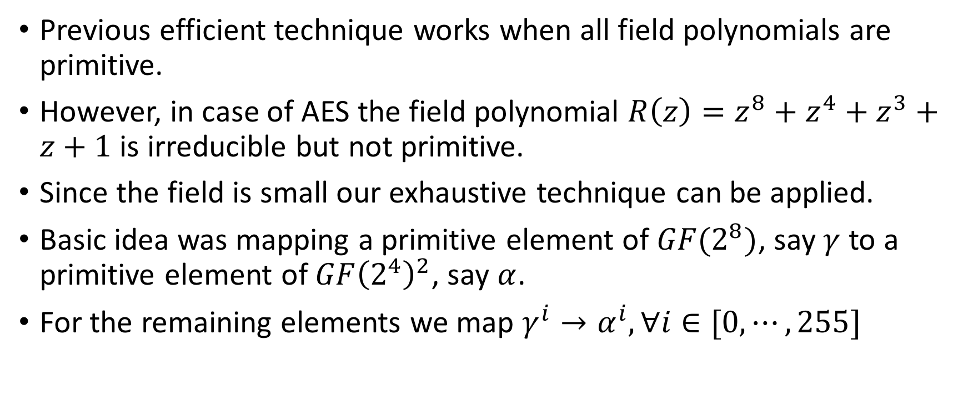
Transforming GF(2⁸) to GF(2⁴)²
Previous efficient technique works when all field polynomials are primitive.
However, in case of AES the field polynomial $R\left(z\right)=z^{8}+z^{4}+z^{3}+z+1$ is irreducible but not primitive.
Since the field is small our exhaustive technique can be applied.
Basic idea was mapping a primitive element of $GF(2^{8})$, say $γ$ to a primitive element of $GF{\left(2^{4}\right)}^{2}$, say $α$.
For the remaining elements we map $γ^{i}→α^{i}, ∀i∈[0,⋯, 255]$

Slide 6
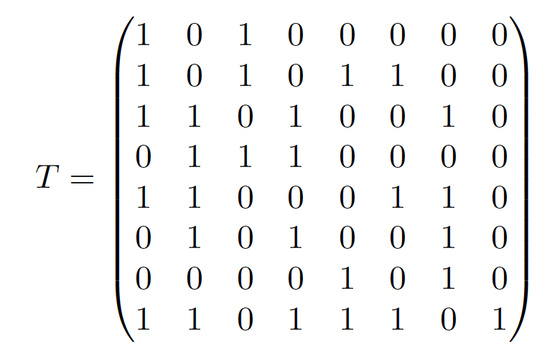
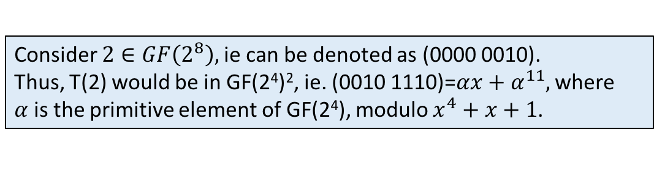
An Example T from GF(2⁸) to GF(2⁴)²
Consider $2∈GF\left(2^{8}\right),$ie can be denoted as (0000 0010).
Thus, T(2) would be in GF(2⁴)², ie. (0010 1110)=$αx+α^{11},$where $α$is the primitive element of GF(2⁴), modulo $x^{4}+x+1$.
Atri Rudra, Pradeep K. Dubey, Charanjit S. Jutla, Vijay Kumar, Josyula R. Rao, Pankaj Rohatgi:Efficient Rijndael Encryption Implementation with Composite Field Arithmetic. CHES 2001: 171-184

Slide 7
Mix Columns in Composite Fields
In Composite Fields
Consider the composite field GF((2⁴)²) with
irreducible polynomial
Every element in this field is represented
as a₁x + a₀ , where a₁ and a₀ Є GF(2⁴)

Slide 8
The Decryption Flow
Add Round Key
Keymem
Add Round Key
Add Round Key
Keymem
Buffer
Buffer
Buffer
InvShift Row
Byte Sub
Inv ByteSub
Shift Row
Inv Byte Sub
Inv Shift Row
Mix Column
Add RoundKey
Keymem
Inv Mix Column
Buffer
Buffer
Buffer
Keymem
Inv Mix
Column
Add Round Key
Keymem
Inv Mix Column
Add Round Key
Buffer
Buffer
Buffer
Byte Sub
Inv Shift Row
Inv Byte Sub
Shift Row
Inv Byte Sub
Inv Shift Row
Keymem
Add Round Key
Keymem
Add Round Key
Keymen
Add Round Key
Buffer
Buffer
Buffer

Slide 9
Some Points
The order of InvShift Rows and InvSubBytes is indifferent.
The order of AddRoundKey and InvMixColumns can be inverted if the round key is adapted accordingly.

Slide 10
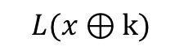
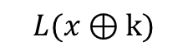
A Linear transformation can be pushed through an XOR
k
x
L
$$L(x⊕k)$$
k
L
x
L
$$L(x⊕k)$$

Slide 11
Encryption steps for two round AES variant
AddRoundKey(State, ExpandedKey[0]);
SubBytes(State);
ShiftRow(State);
MixColumn(State);
AddRoundKey(State, ExpandedKey[1]);
SubBytes(State);
ShiftRow(State);
AddRoundKey(State, ExpandedKey[2]);

Slide 12
Decryption steps for two round AES variant
AddRoundKey(State, ExpandedKey[2]);
InvShiftRow(State);
InvSubBytes(State);
AddRoundKey(State, ExpandedKey[1]);
InvMixColumn(State);
InvShiftRow(State);
InvSubBytes(State);
AddRoundKey(State, ExpandedKey[0]);

Slide 13
Equivalent Decryption steps for two round AES variant
AddRoundKey(State, ExpandedKey[2]);
InvSubBytes(State);
InvShiftRow(State);
InvMixColumn(State);
AddRoundKey(State, EqExpandedKey[1]);
InvSubBytes(State);
InvShiftRow(State);
AddRoundKey(State, ExpandedKey[0]);

Slide 14
Equivalent Decryption
The equivalent key-scheduling can be obtained by applying InvMixColumns after the key-scheduling algorithm.
This can be generalized to the full round AES.
Thus we see that in the equivalent decryption the sequence of steps is similar.
This helps implementation

Slide 15
Compact Encryption-Decryption Architecture
Merge the operations in the encryption and decryption into a single unit.
Key-Gen
Key
Memory
Input Data
Data
Schedule
Encrypt/
Decrypt
Dispatch
Unit
Enc/ Dec

Slide 16
Merged Round Operations
Addroundkey is the same in both encryption and decryption
ShiftRows and InverseShiftRows only differ in the direction of shifting

Slide 17
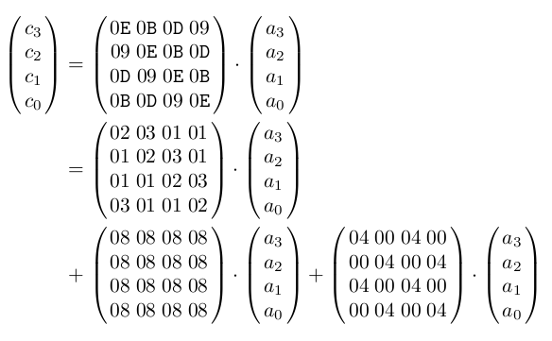
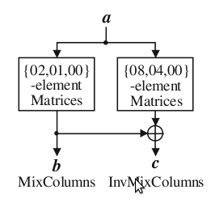
Merged Mix Columns
A. Satoh et. al., A compact Rijndael Hardware Architecture with S-box Optimization, ASIACRYPT 2001
 | Separate Mix (Inv) Columns | Merged Mix Columns
No. of XOR gates | 152 + 440 = 592 | 195
Delay (gates) | 5 | 7

Slide 18
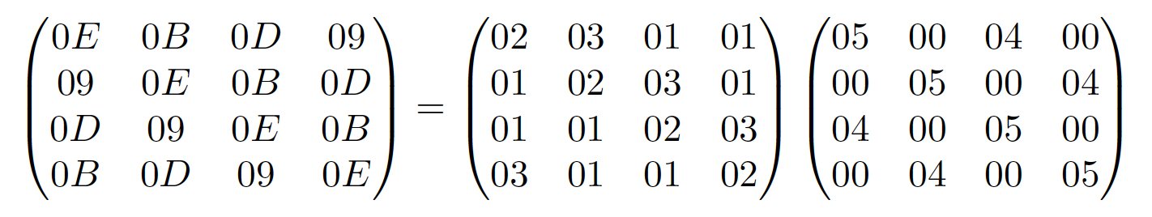
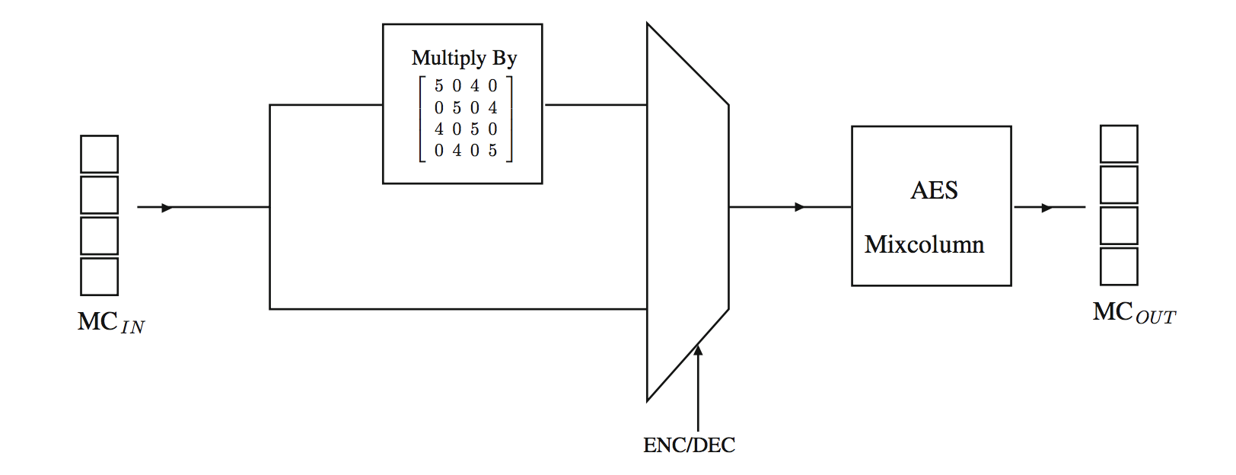
Another InvMixColumn Design
Gate-count around 166 XORs and a 32-bit MUX.
Subhadeep Banik, Andrey Bogdanov, Francesco Regazzoni:Atomic-AES: A Compact Implementation of the AES Encryption/Decryption Core. INDOCRYPT 2016: 173-190

Slide 19
Merged S-boxes
Map
Reverse
Map,
Affine
x
or
Sbox[x]
Inverse in Composite Field
eg. In GF((2⁴)²)
Sbox[x]
or x
Reverse
Map
Map,
Revse Affine
Type | Total Gates in terms of NAND gates using std cell library
Sbox + InvSbox | 362
Merged | 234
# D. Canright, A Very Compact S-box for AES, CHES-2005

Slide 20
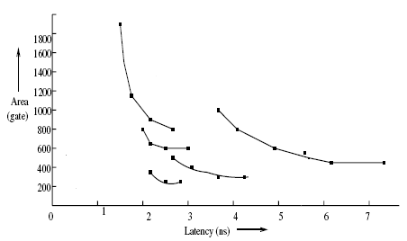
Different Schools of Designs
Verbauwhede
Wolkerstorfer
Hodjat
Alam
Satoh
J.Wolkerstorfer, E.Oswald and M. Lamberger: An ASIC Implementation of the AES S-boxes: in Proc. RSA Conference (CT-RSA) 2002, LNCS Vol. 2271, pp.67-78, San Jose, CA, Feb. 2002.
M. Alam et. al., An Area Optimized Reconfigurable Encryptor for AES-Rijndael, DATE 2007
A. Satoh et. al., A compact Rijndael Hardware Architecture with S-box Optimization, ASIACRYPT 2001
I. Verbauwhede, P. Schaumont, H. KuoDesign and Performance Testing of a 2.29-GB/s Rijndael Processor, IEEE Journal of Solid State Circuit, 2003.
A . Hodjat et. al. Area Throughput Tradeoffs for Fully Pipelined 30 to 70 Gbits/s AES Processors, IEEE Trans on Computers 2006

Slide 21
State of the Art
Intel has introduced dedicated hardware for AES on its microprocessors
These are accessed by dedicated AES instructions
The AES design consists of:
Standard techniques used such as composite fields, single map – reverse map, etc.
Speed of 53Gbps obtained by fully custom design flow on 45nm technology.
S. Mathew, 53Gbps Native GF(2⁴)² Composite Field AES-Encrypt/Decrypt Accelerator for Content Protection in 45nm
High Performance Microprocessors,VTS 2010

Slide 22
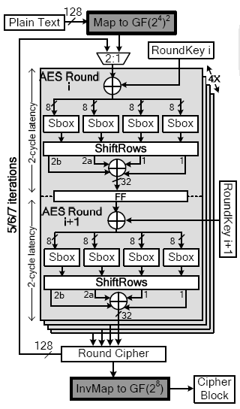
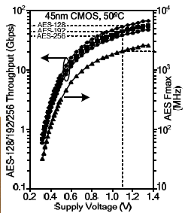
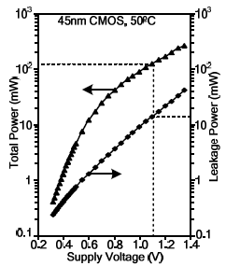
Intel’s AES Hardware
S. Mathew, 53Gbps Native GF(2⁴⁾² Composite Field AES-Encrypt/Decrypt Accelerator for Content Protection in 45nm
High Performance Microprocessors,VTS 2010

Slide 23


Slide 24
Conclusion:
Expressing AES in composite fields.
Techniques using Isomorphism efficient for S-boxes.
MixColumns and Inverse MixColumns can be efficiently combined.
Encryption and decryption of AES can be made similar by using its structure.
Combined encryption and decryption saves gates.

Slide 25


